Slide 1
Denoising Diffusion Implicit Models
Jiaming Song, Chenlin Meng, Stefano Ermon
모바일시스템공학과
박찬호
Song, Jiaming, Chenlin Meng, and Stefano Ermon. "Denoising Diffusion Implicit Models." International Conference on Learning Representation(2020).

Slide 2
Contents
Before Getting Started
Diffusion Model
DDPM
DDIM
Non-Markovian Forward Process
Generative Process

Slide 3
Before Getting Started
Song, Jiaming, Chenlin Meng, and Stefano Ermon
International Conference on Learning Representations.
2020
Diffusion with Non-Markovian process
DDPM diffusion + DDIM sampling

Slide 4
Before Getting Started
Generative Models Timeline
2014
2015
2016
2017
2018
2019
2020
2021
2022
VAE
Original GAN
PixelRNN
EBGAN
DDPM
DDIM
StyleGAN
Stable Diffusion
DCGAN
First Diffusion*
First Flow-based**
CycleGAN
DeepFakes
PixelCNN++
SAGAN
Score-Based Generative Modeling through Stochastic Differential Equations
Diffusion Models Beat GANs on Image Synthesis
* Jascha Sohl-Dickstein et al. Unsupervised Learning using Nonequilibrium Thermodynamics ** Danilo Jimenez Rezende; Mohamed, Shakir. Variational Inference with Normalizing Flows

Slide 5
Before Getting Started
Generative Models Timeline
2014
2015
2016
2017
2018
2019
2020
2021
2022
VAE
Original GAN
PixelRNN
EBGAN
DDPM
DDIM
StyleGAN
Stable Diffusion
DCGAN
First Diffusion*
First Flow-based**
CycleGAN
DeepFakes
PixelCNN++
SAGAN
Score-Based Generative Modeling through Stochastic Differential Equations
Diffusion Models Beat GANs on Image Synthesis
* Jascha Sohl-Dickstein et al. Unsupervised Learning using Nonequilibrium Thermodynamics ** Danilo Jimenez Rezende; Mohamed, Shakir. Variational Inference with Normalizing Flows

Slide 6
Before Getting Started
Generative Models Timeline
2014
2015
2016
2017
2018
2019
2020
2021
2022
VAE
Original GAN
PixelRNN
EBGAN
DDPM
DDIM
StyleGAN
Stable Diffusion
DCGAN
First Diffusion*
First Flow-based**
CycleGAN
DeepFakes
PixelCNN++
SAGAN
Score-Based Generative Modeling through Stochastic Differential Equations
Diffusion Models Beat GANs on Image Synthesis
* Jascha Sohl-Dickstein et al. Unsupervised Learning using Nonequilibrium Thermodynamics ** Danilo Jimenez Rezende; Mohamed, Shakir. Variational Inference with Normalizing Flows

Slide 7
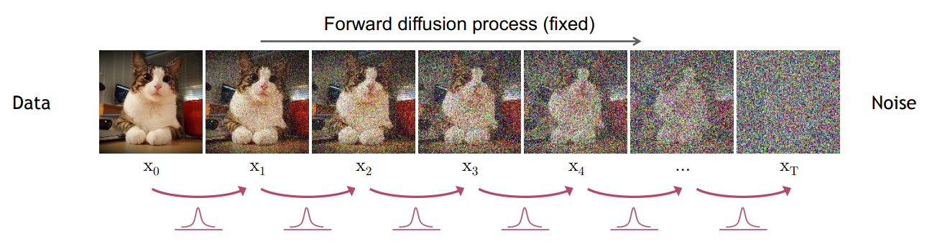
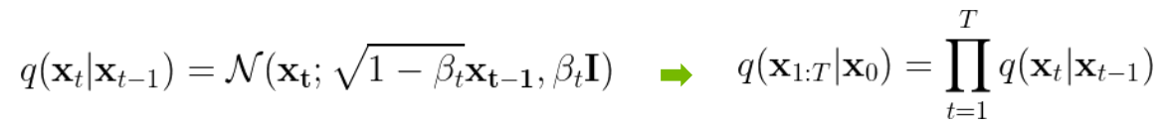
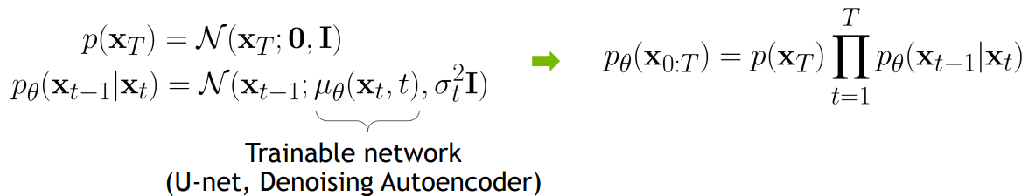
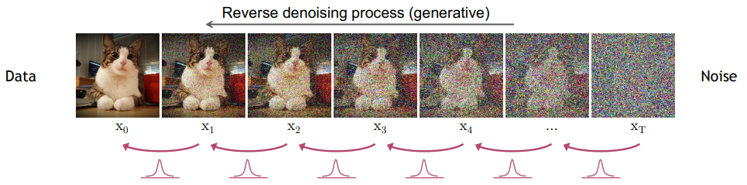
DDPM

Slide 8
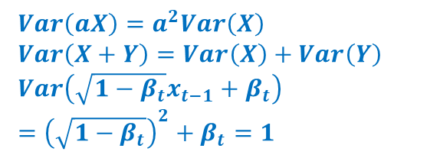
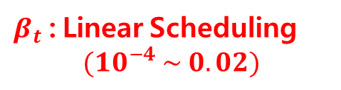
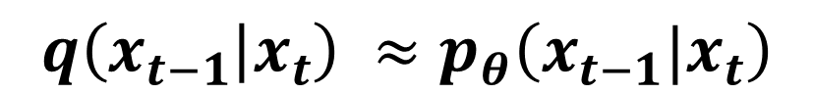
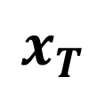
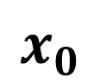
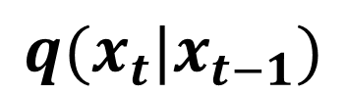
DDPM
$$q(x_{t}|x_{t−1})$$
$$x_{0}$$
$$x_{T}$$
$β_{t}$ : Linear Scheduling
$$(10^{−4} \sim 0.02)$$
Standard Gaussian
$Var\left(aX\right)=a^{2}Var\left(X\right)$
$Var\left(X+Y\right)=Var\left(X\right)+Var\left(Y\right)$
$Var\left(\sqrt{1−β_{t}}x_{t−1}+β_{t}\right)$
$={\left(\sqrt{1−β_{t}}\right)}^{2}+β_{t}=1$
Markov Chain
Constant
$$q\left(x_{t−1} | x_{t}\right) ≈p_{θ}\left(x_{t−1}|x_{t}\right)$$

Slide 9
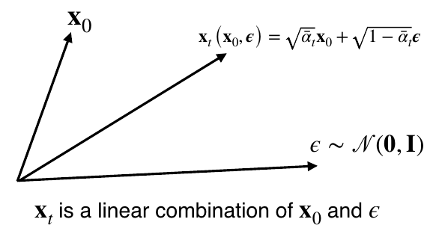
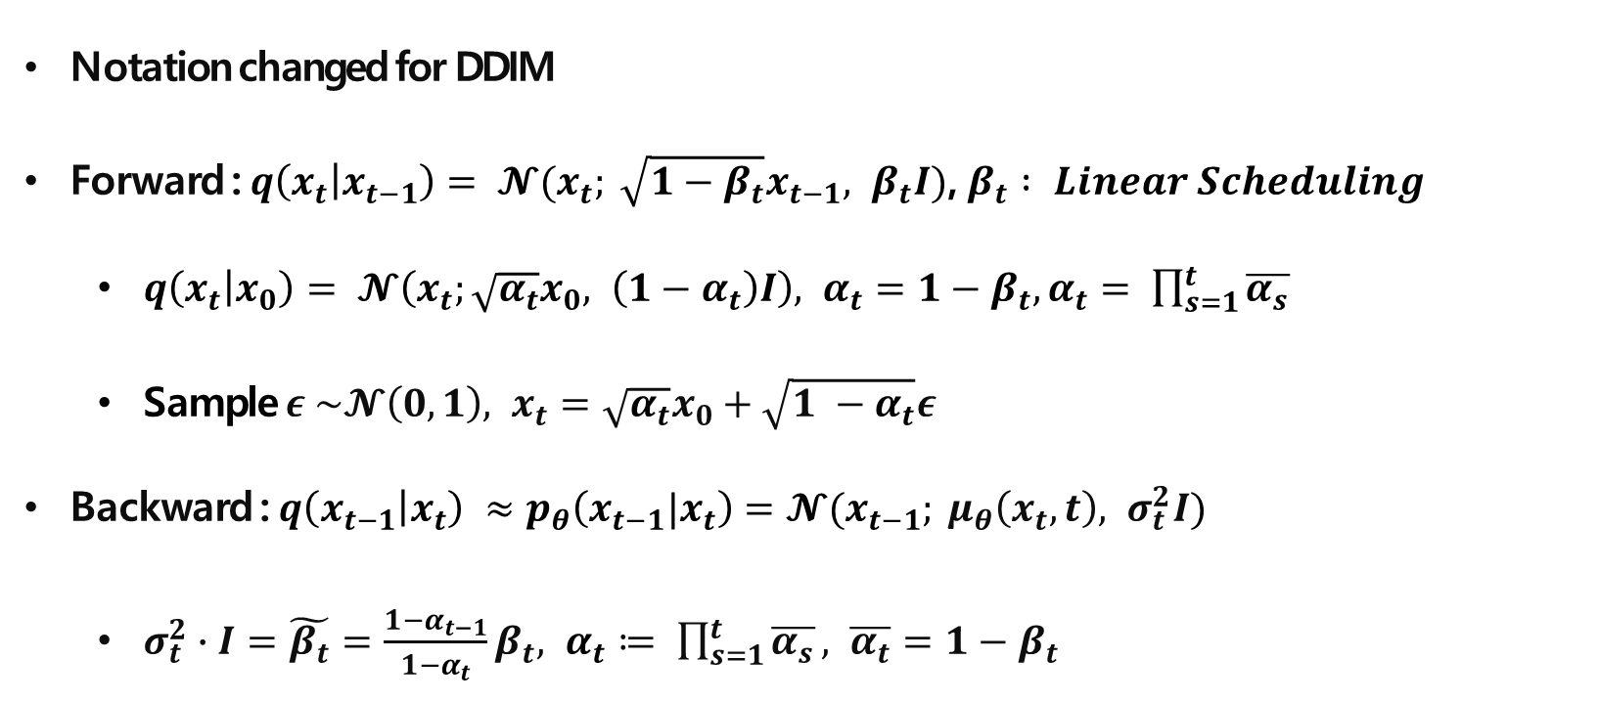
DDPM
Notation changed for DDIM
Forward : $q\left(x_{t} | x_{t−1}\right)= 𝓝(x_{t}; \sqrt{1−β_{t}}x_{t−1}, β_{t}I)$, $β_{t} : Linear Scheduling$
$q\left(x_{t} | x_{0}\right)= 𝓝\left(x_{t};\sqrt{α_{t}}x_{0}, \left(1−α_{t}\right)I\right), α_{t}=1−β_{t},α_{t}= \prod_{s=1}^{t}{\overline{α_{s}}}$
Sample $ε \sim 𝓝\left(0, 1\right), x_{t}=\sqrt{α_{t}}x_{0}+\sqrt{1 −α_{t}}ε$
Backward : $q\left(x_{t−1} | x_{t}\right) ≈p_{θ}\left(x_{t−1}|x_{t}\right)=𝓝(x_{t−1}; μ_{θ}\left(x_{t}, t\right), σ_{t}^{2}I)$
$σ_{t}^{2}∙I=\tilde{β_{t}}=\frac{1−α_{t−1}}{1−α_{t}}β_{t}, α_{t}≔ \prod_{s=1}^{t}{\overline{α_{s}}}, \overline{α_{t}}=1−β_{t}$

Slide 10
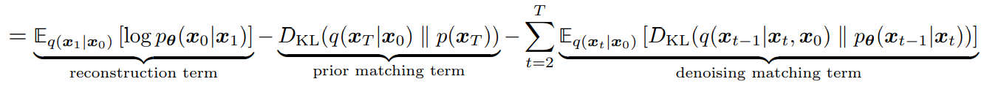
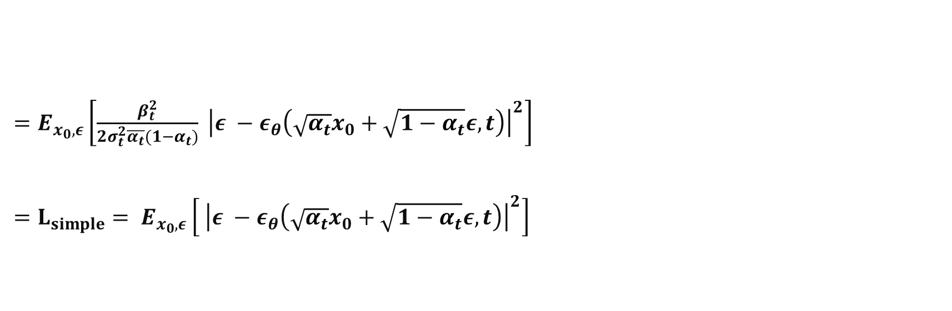
DDPM - Loss
$=E_{x_{0}, ε}\left[\frac{β_{t}^{2}}{2σ_{t}^{2}\overline{α_{t}}(1−α_{t})} {\left|ε −ε_{θ}\left(\sqrt{α_{t}}x_{0}+\sqrt{1−α_{t}}ε, t\right)\right|}^{2}\right]$
$=L_{simple}= E_{x_{0}, ε}\left[ {\left|ε −ε_{θ}\left(\sqrt{α_{t}}x_{0}+\sqrt{1−α_{t}}ε, t\right)\right|}^{2}\right]$

Slide 11
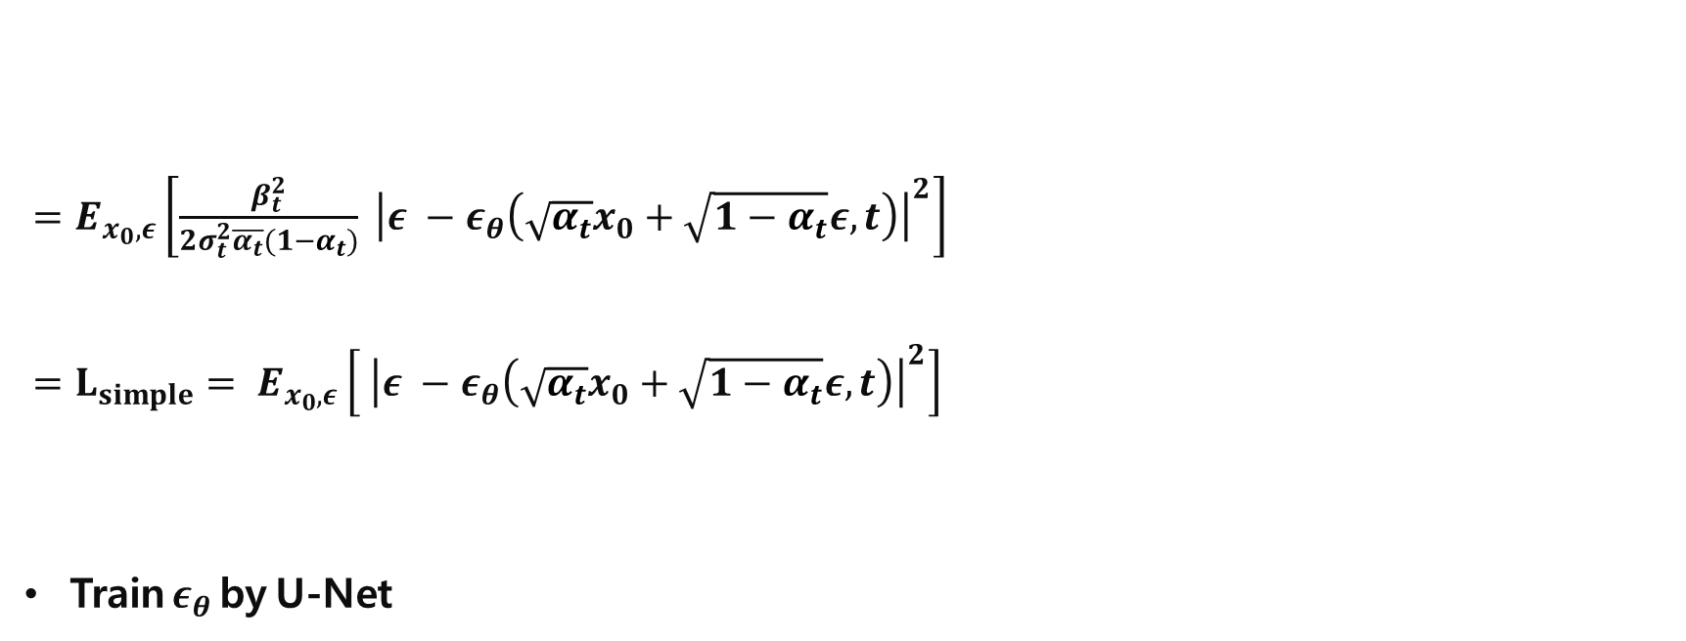
DDPM - Loss
$=E_{x_{0}, ε}\left[\frac{β_{t}^{2}}{2σ_{t}^{2}\overline{α_{t}}(1−α_{t})} {\left|ε −ε_{θ}\left(\sqrt{α_{t}}x_{0}+\sqrt{1−α_{t}}ε, t\right)\right|}^{2}\right]$
$=L_{simple}= E_{x_{0}, ε}\left[ {\left|ε −ε_{θ}\left(\sqrt{α_{t}}x_{0}+\sqrt{1−α_{t}}ε, t\right)\right|}^{2}\right]$
Train $ε_{θ}$ by U-Net
Decreases as time step t increases
Set as 1
MSE between trained epsilon and sample from Standard Gaussian

Slide 12
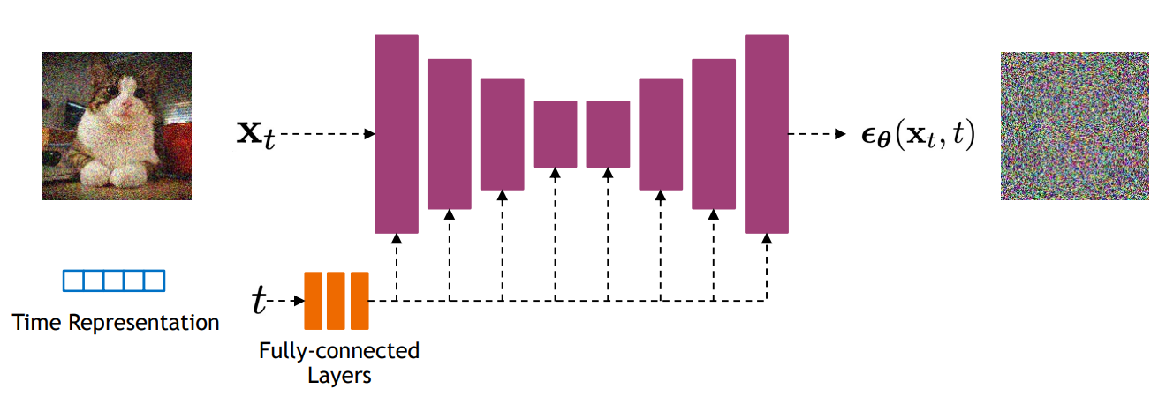
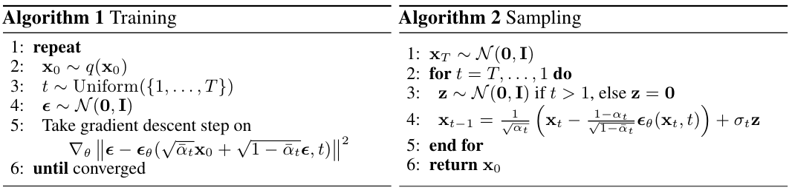
DDPM - Architecture
Backbone of PixelCNN++, which is a U-Net based on ResNet
U-Net with self attention, time representation
U-Net is shared through training
https://nn.labml.ai/diffusion/ddpm/unet.html

Slide 13
DDPM

Slide 14
Plan
DDPM
DDIM
Score-Based Generative Modeling through Stochastic Differential Equations
Diffusion Models Beat GANs on Image Synthesis (Classifier Guidance)
High-Resolution Image Synthesis with Latent Diffusion Models (Latent diffusion)

Slide 15
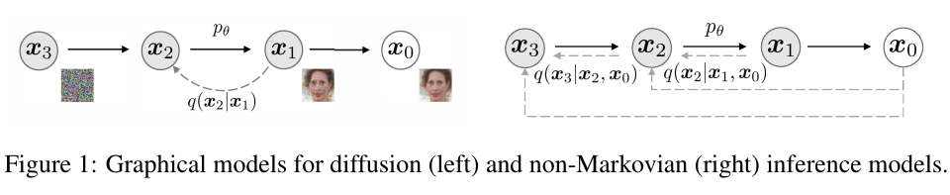
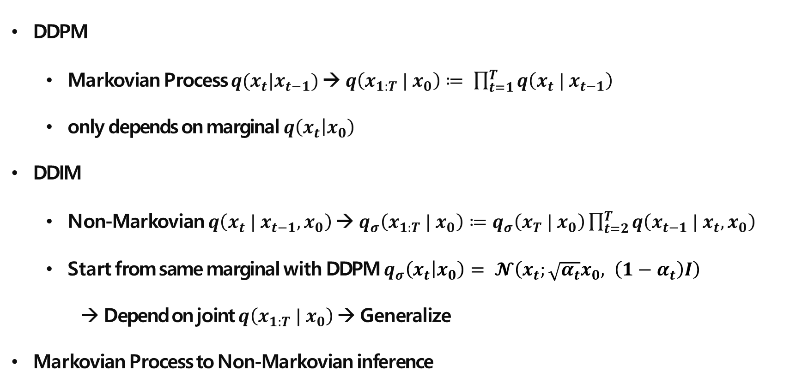
DDIM
DDPM
Markovian Process $q(x_{t}|x_{t−1})$ → $q\left(x_{1:T} | x_{0}\right)≔ \prod_{t=1}^{T}{q\left(x_{t} | x_{t−1}\right)}$
only depends on marginal $q\left(x_{t} | x_{0}\right)$
DDIM
Non-Markovian $q\left(x_{t} | x_{t−1}, x_{0}\right)$ → $q_{σ}\left(x_{1:T} | x_{0}\right)≔q_{σ}\left(x_{T} | x_{0}\right)\prod_{t=2}^{T}{q\left(x_{t−1} | x_{t}, x_{0}\right)}$
Start from same marginal with DDPM $q_{σ}\left(x_{t} | x_{0}\right)= 𝓝\left(x_{t};\sqrt{α_{t}}x_{0}, \left(1−α_{t}\right)I\right)$
→ Depend on joint $q\left(x_{1:T} | x_{0}\right)$ → Generalize
Markovian Process to Non-Markovian inference

Slide 16
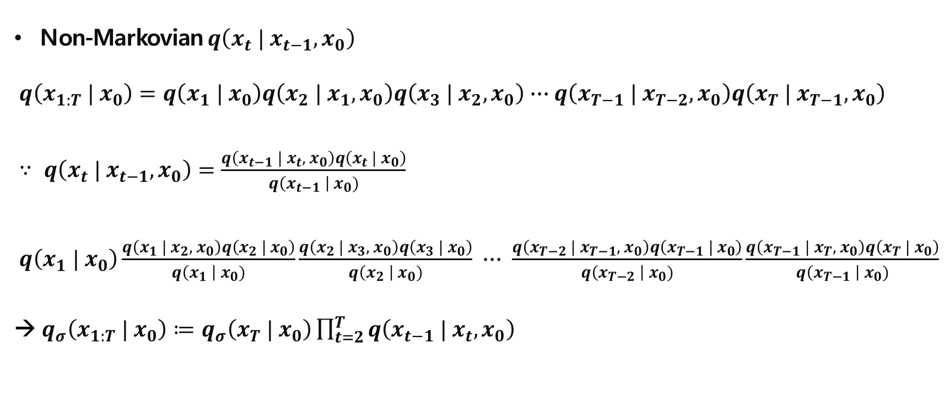
DDIM – Forward
Non-Markovian $q\left(x_{t} | x_{t−1}, x_{0}\right)$
$q\left(x_{1:T} | x_{0}\right)=q\left(x_{1} | x_{0}\right)q\left(x_{2} | x_{1}, x_{0}\right)q\left(x_{3} | x_{2}, x_{0}\right)∙∙∙q\left(x_{T−1} | x_{T−2}, x_{0}\right)q\left(x_{T} | x_{T−1}, x_{0}\right)$
$∵ q\left(x_{t} | x_{t−1}, x_{0}\right)=\frac{q\left(x_{t−1} | x_{t}, x_{0}\right)q\left(x_{t} | x_{0}\right)}{q\left(x_{t−1} \right| x_{0})}$
$q\left(x_{1} | x_{0}\right)\frac{q\left(x_{1} | x_{2}, x_{0}\right)q\left(x_{2} | x_{0}\right)}{q\left(x_{1} \right| x_{0})}\frac{q\left(x_{2} | x_{3}, x_{0}\right)q\left(x_{3} | x_{0}\right)}{q\left(x_{2} \right| x_{0})} ∙∙∙ \frac{q\left(x_{T−2} | x_{T−1}, x_{0}\right)q\left(x_{T−1} | x_{0}\right)}{q\left(x_{T−2} \right| x_{0})}\frac{q\left(x_{T−1} | x_{T}, x_{0}\right)q\left(x_{T} | x_{0}\right)}{q\left(x_{T−1} \right| x_{0})}$
→ $q_{σ}\left(x_{1:T} | x_{0}\right)≔q_{σ}\left(x_{T} | x_{0}\right)\prod_{t=2}^{T}{q\left(x_{t−1} | x_{t}, x_{0}\right)}$

Slide 17

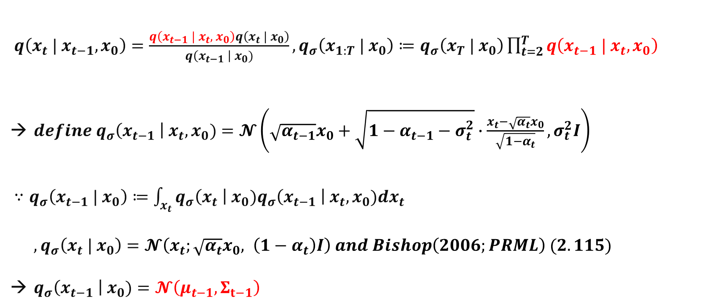

DDIM – Forward
What is $q\left(x_{t−1} | x_{t}, x_{0}\right)$ ?
$q\left(x_{t} | x_{t−1}, x_{0}\right)=\frac{q\left(x_{t−1} | x_{t}, x_{0}\right)q\left(x_{t} | x_{0}\right)}{q\left(x_{t−1} \right| x_{0})}, q_{σ}\left(x_{1:T} | x_{0}\right)≔q_{σ}\left(x_{T} | x_{0}\right)\prod_{t=2}^{T}{q\left(x_{t−1} | x_{t}, x_{0}\right)}$
$define q_{σ}\left(x_{t−1} \right| x_{t}, x_{0})=𝓝\left(\sqrt{α_{t−1}}x_{0}+\sqrt{1−α_{t−1}−σ_{t}^{2}}∙\frac{x_{t}−\sqrt{α_{t}}x_{0}}{\sqrt{1−α_{t}}}, σ_{t}^{2}I\right)$
$∵q_{σ}\left(x_{t−1} | x_{0}\right)≔\int_{x_{t}}{q_{σ}\left(x_{t} \right| x_{0})q_{σ}\left(x_{t−1} \right| x_{t}, x_{0})dx_{t}}$
$, q_{σ}\left(x_{t} | x_{0}\right)=𝓝\left(x_{t};\sqrt{α_{t}}x_{0}, \left(1−α_{t}\right)I\right) and Bishop\left(2006;PRML\right) (2.115)$
$q_{σ}\left(x_{t−1} \right| x_{0})=𝓝\left(μ_{t−1}, Σ_{t−1}\right)$
What is $μ_{t−1}, Σ_{t−1}$ ?

Slide 18
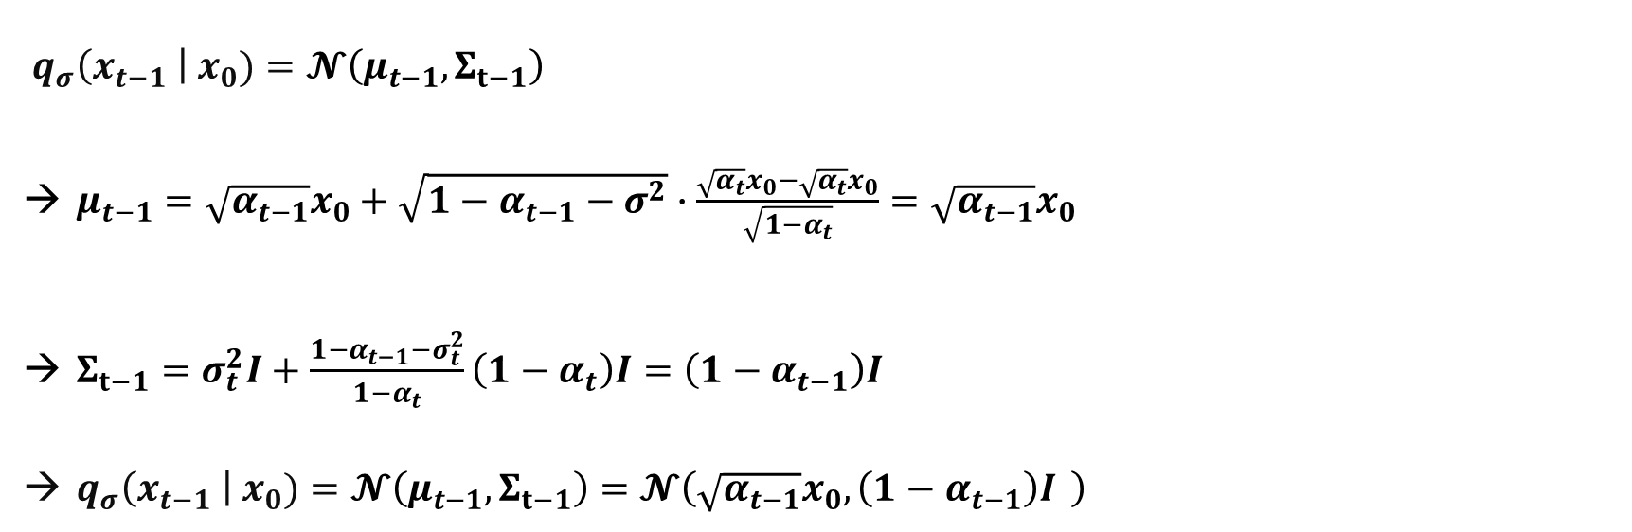
DDIM – Forward
$q_{σ}\left(x_{t−1} \right| x_{0})=𝓝\left(μ_{t−1}, Σ_{t−1}\right)$
$μ_{t−1}=\sqrt{α_{t−1}}x_{0}+\sqrt{1−α_{t−1}−σ^{2}}∙\frac{\sqrt{α_{t}}x_{0}−\sqrt{α_{t}}x_{0}}{\sqrt{1−α_{t}}}=\sqrt{α_{t−1}}x_{0}$
$Σ_{t−1}=σ_{t}^{2}I+\frac{1−α_{t−1}−σ_{t}^{2}}{1−α_{t}}\left(1−α_{t}\right)I=\left(1−α_{t−1}\right)I$
$q_{σ}\left(x_{t−1} \right| x_{0})=𝓝\left(μ_{t−1}, Σ_{t−1}\right)=𝓝\left(\sqrt{α_{t−1}}x_{0},\left(1−α_{t−1}\right)I \right)$

Slide 19
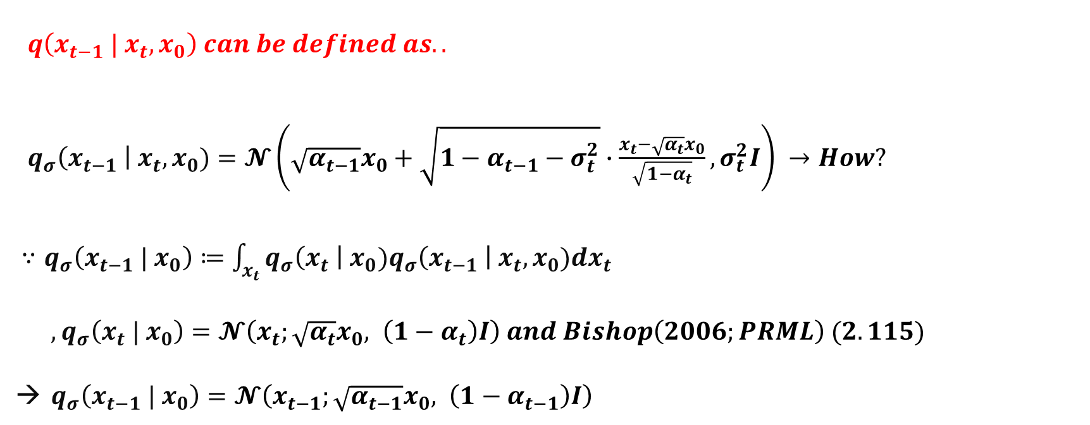
DDIM – Forward
$q\left(x_{t−1} | x_{t}, x_{0}\right) can be defined as..$
$q_{σ}\left(x_{t−1} \right| x_{t}, x_{0})=𝓝\left(\sqrt{α_{t−1}}x_{0}+\sqrt{1−α_{t−1}−σ_{t}^{2}}∙\frac{x_{t}−\sqrt{α_{t}}x_{0}}{\sqrt{1−α_{t}}}, σ_{t}^{2}I\right) →How?$
$∵q_{σ}\left(x_{t−1} | x_{0}\right)≔\int_{x_{t}}{q_{σ}\left(x_{t} \right| x_{0})q_{σ}\left(x_{t−1} \right| x_{t}, x_{0})dx_{t}}$
$, q_{σ}\left(x_{t} | x_{0}\right)=𝓝\left(x_{t};\sqrt{α_{t}}x_{0}, \left(1−α_{t}\right)I\right) and Bishop\left(2006;PRML\right) (2.115)$
$q_{σ}\left(x_{t−1} | x_{0}\right)=𝓝\left(x_{t−1};\sqrt{α_{t−1}}x_{0}, \left(1−α_{t−1}\right)I\right)$

Slide 20
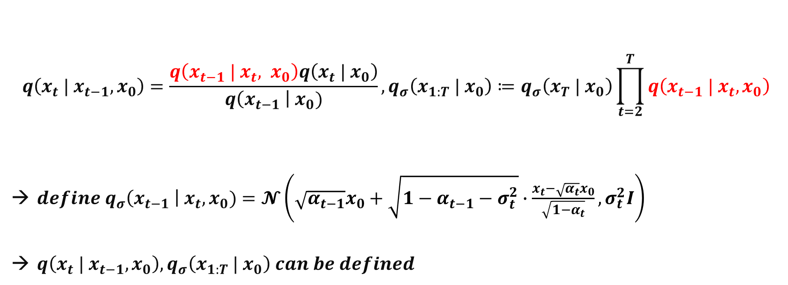
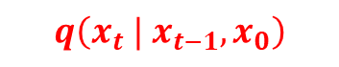
DDIM – Forward
$$q\left(x_{t} | x_{t−1}, x_{0}\right)=\frac{q\left(x_{t−1} | x_{t}, x_{0}\right)q\left(x_{t} | x_{0}\right)}{q\left(x_{t−1} \right| x_{0})}, q_{σ}\left(x_{1:T} | x_{0}\right)≔q_{σ}\left(x_{T} | x_{0}\right)\prod_{t=2}^{T}{q\left(x_{t−1} | x_{t}, x_{0}\right)}$$
$define q_{σ}\left(x_{t−1} \right| x_{t}, x_{0})=𝓝\left(\sqrt{α_{t−1}}x_{0}+\sqrt{1−α_{t−1}−σ_{t}^{2}}∙\frac{x_{t}−\sqrt{α_{t}}x_{0}}{\sqrt{1−α_{t}}}, σ_{t}^{2}I\right)$
$q\left(x_{t} | x_{t−1}, x_{0}\right), q_{σ}\left(x_{1:T} | x_{0}\right) can be defined$
$$q\left(x_{t} | x_{t−1}, x_{0}\right)$$
Non-Markovian

Slide 21
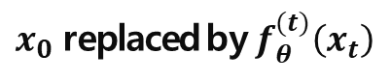
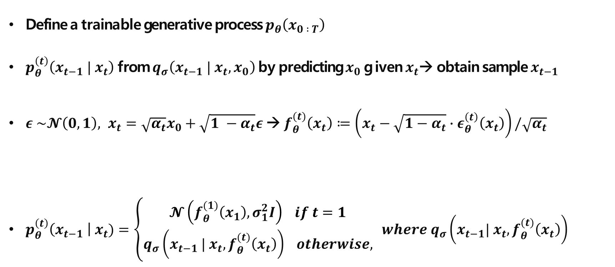
DDIM – Backward
Define a trainable generative process $p_{θ}\left(x_{0 : T}\right)$
$p_{θ}^{\left(t\right)}\left(x_{t−1} | x_{t}\right)$ from $q_{σ}\left(x_{t−1} | x_{t}, x_{0}\right)$ by predicting $x_{0}$ g iven $x_{t}$→ obtain sample $x_{t−1}$
$ε \sim 𝓝\left(0, 1\right), x_{t}=\sqrt{α_{t}}x_{0}+\sqrt{1 −α_{t}}ε$ → $f_{θ}^{(t)}\left(x_{t}\right)≔\left(x_{t}−\sqrt{1−α_{t}}∙ε_{θ}^{\left(t\right)}\left(x_{t}\right)\right)/\sqrt{α_{t}}$
$p_{θ}^{\left(t\right)}\left(x_{t−1} \right| x_{t})=\left\{\begin{aligned}𝓝\left(f_{θ}^{(1)}\left(x_{1}\right), σ_{1}^{2}I\right) if t=1 \\ q_{σ}\left(x_{t−1} | x_{t},f_{θ}^{(t)}\left(x_{t}\right)\right) otherwise,\end{aligned}\right. where q_{σ}\left(x_{t−1}| x_{t},f_{θ}^{(t)}\left(x_{t}\right)\right)$
$x_{0}$ replaced by $f_{θ}^{(t)}\left(x_{t}\right)$

Slide 22
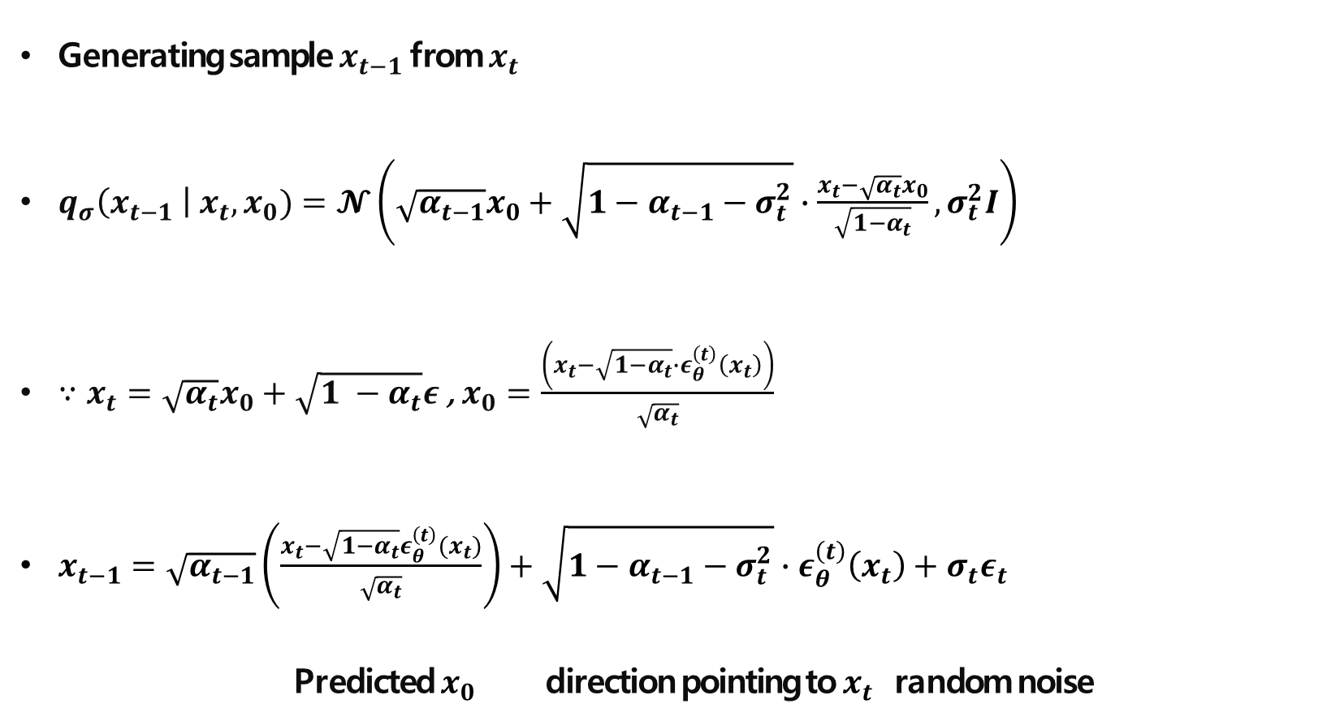
DDIM – Backward
Generating sample $x_{t−1}$ from $x_{t}$
$q_{σ}\left(x_{t−1} \right| x_{t}, x_{0})=𝓝\left(\sqrt{α_{t−1}}x_{0}+\sqrt{1−α_{t−1}−σ_{t}^{2}}∙\frac{x_{t}−\sqrt{α_{t}}x_{0}}{\sqrt{1−α_{t}}}, σ_{t}^{2}I\right)$
$∵x_{t}=\sqrt{α_{t}}x_{0}+\sqrt{1 −α_{t}}ε$ , $x_{0}=\frac{\left(x_{t}−\sqrt{1−α_{t}}∙ε_{θ}^{\left(t\right)}\left(x_{t}\right)\right)}{\sqrt{α_{t}}}$
$x_{t−1}=\sqrt{α_{t−1}}\left(\frac{x_{t}−\sqrt{1−α_{t}}ε_{θ}^{\left(t\right)}(x_{t})}{\sqrt{α_{t}}}\right)+\sqrt{1−α_{t−1}−σ_{t}^{2}}∙ε_{θ}^{\left(t\right)}\left(x_{t}\right)+σ_{t}ε_{t}$
Predicted $x_{0}$ direction pointing to $x_{t}$ random noise

Slide 23
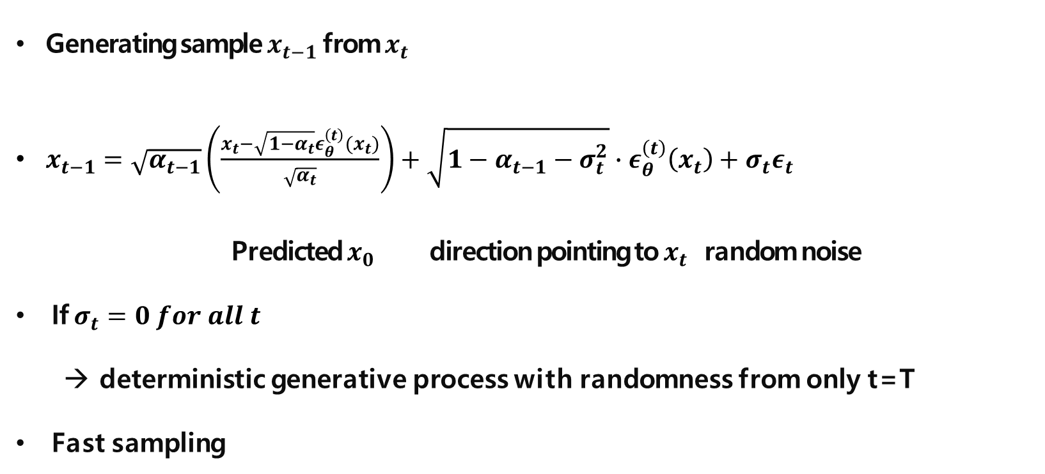
DDIM – Backward
Generating sample $x_{t−1}$ from $x_{t}$
$x_{t−1}=\sqrt{α_{t−1}}\left(\frac{x_{t}−\sqrt{1−α_{t}}ε_{θ}^{\left(t\right)}(x_{t})}{\sqrt{α_{t}}}\right)+\sqrt{1−α_{t−1}−σ_{t}^{2}}∙ε_{θ}^{\left(t\right)}\left(x_{t}\right)+σ_{t}ε_{t}$
Predicted $x_{0}$ direction pointing to $x_{t}$ random noise
If $σ_{t}=0 for all t$
deterministic generative process with randomness from only t=T
Fast sampling

Slide 24
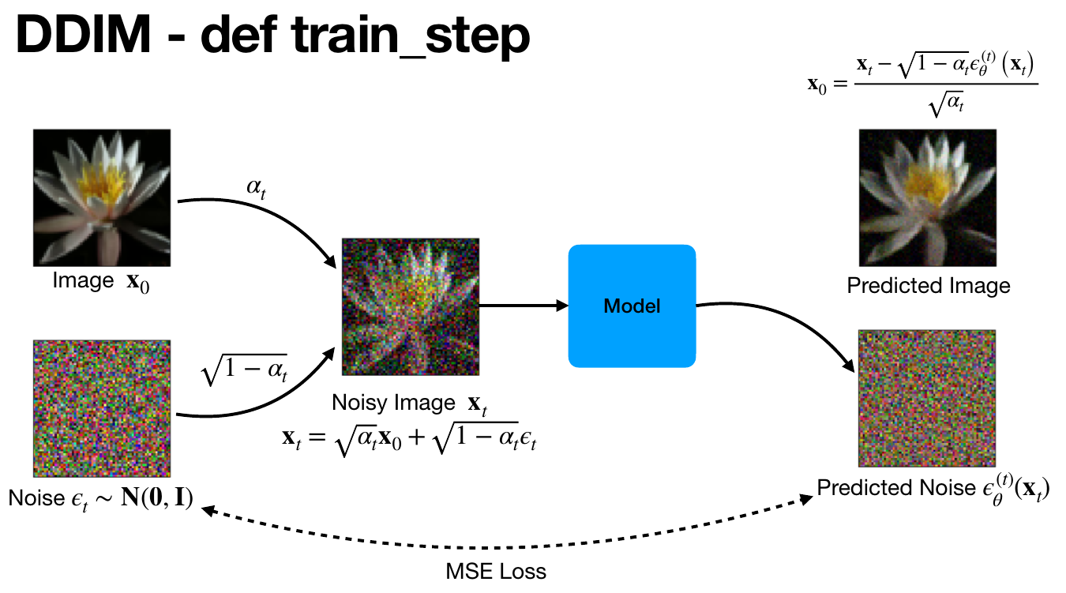
DDIM – Diagram – training
[DLD 2022] Denoising Diffusion Implicit Models – 박수철 (https://aifactory.space/learning/detail/2172)

Slide 25
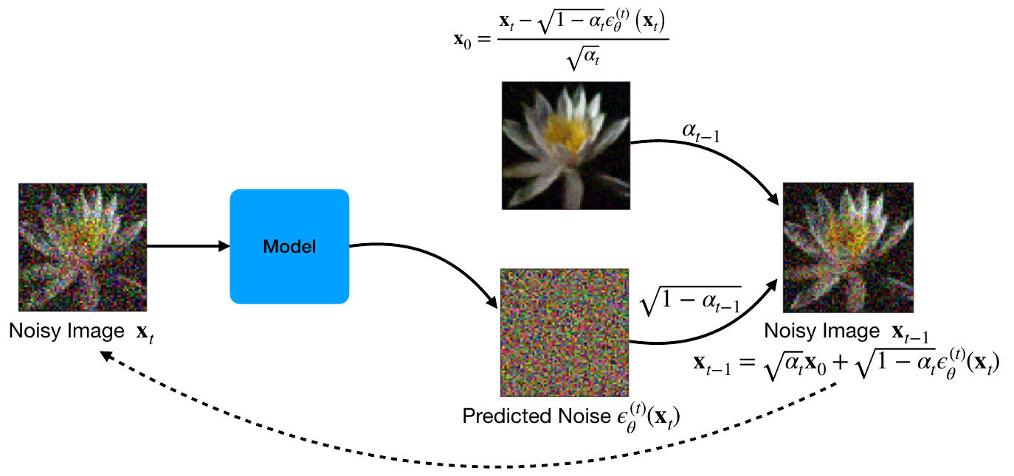
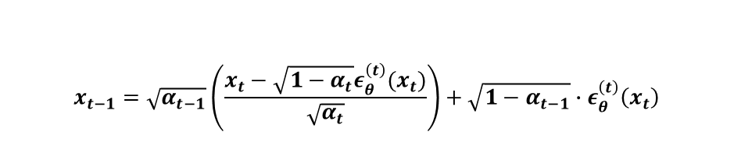
DDIM – Diagram – sampling
$$x_{t−1}=\sqrt{α_{t−1}}\left(\frac{x_{t}−\sqrt{1−α_{t}}ε_{θ}^{\left(t\right)}(x_{t})}{\sqrt{α_{t}}}\right)+\sqrt{1−α_{t−1}}∙ε_{θ}^{\left(t\right)}\left(x_{t}\right)$$
[DLD 2022] Denoising Diffusion Implicit Models – 박수철 (https://aifactory.space/learning/detail/2172)

Slide 26
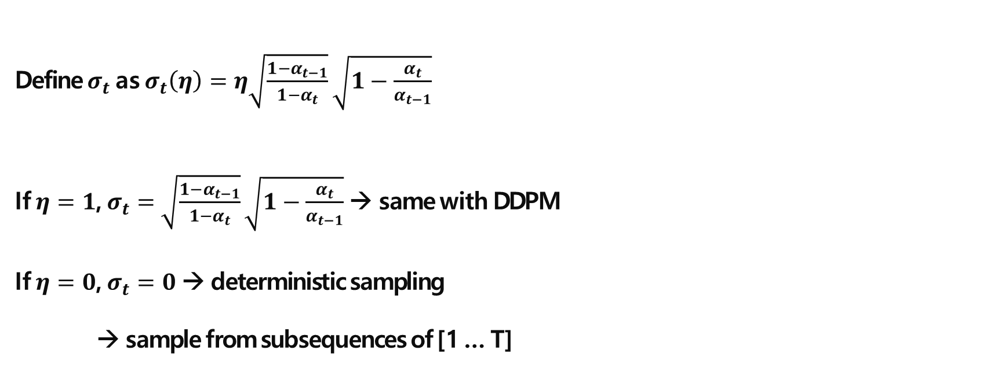
DDIM – Experiments
Define $σ_{t}$ as $σ_{t}\left(η\right)=η\sqrt{\frac{1−α_{t−1}}{1−α_{t}}}\sqrt{1−\frac{α_{t}}{α_{t−1}}}$
If $η=1$, $σ_{t}=$ $\sqrt{\frac{1−α_{t−1}}{1−α_{t}}}\sqrt{1−\frac{α_{t}}{α_{t−1}}}$ → same with DDPM
If $η=0$, $σ_{t}=0$ → deterministic sampling
→ sample from subsequences of [1 … T]

Slide 27
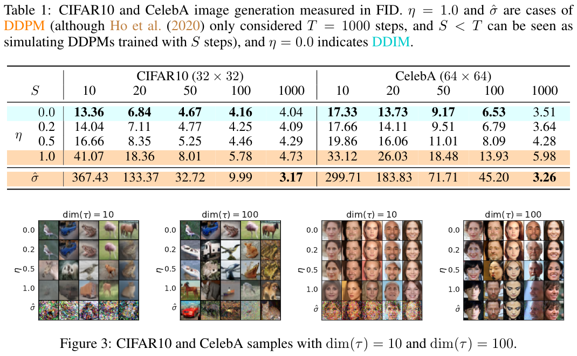
DDIM – Experiments

Slide 28
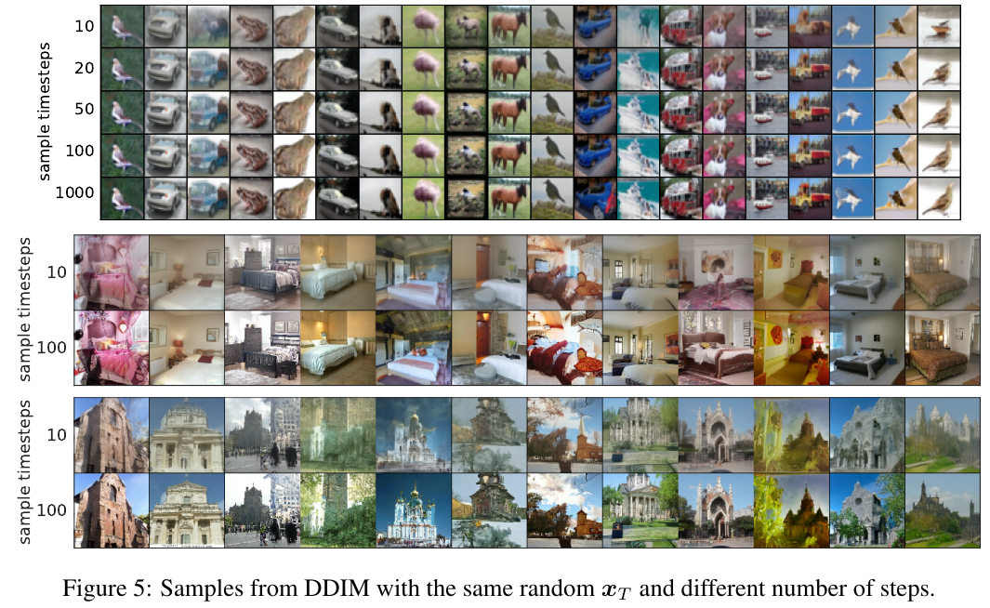
DDIM – Experiments

Slide 29
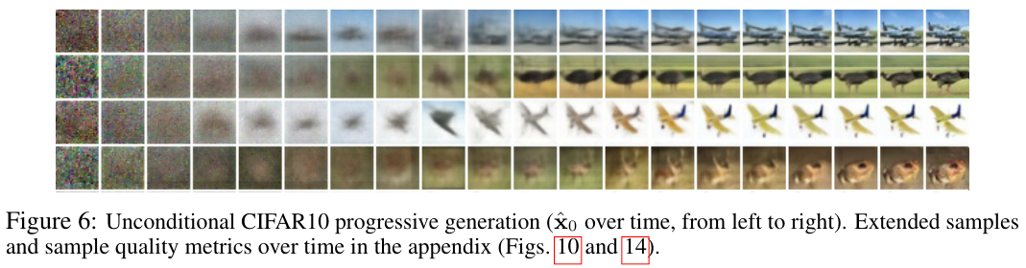
DDPM – Experiments
High-level features are determined

Slide 30
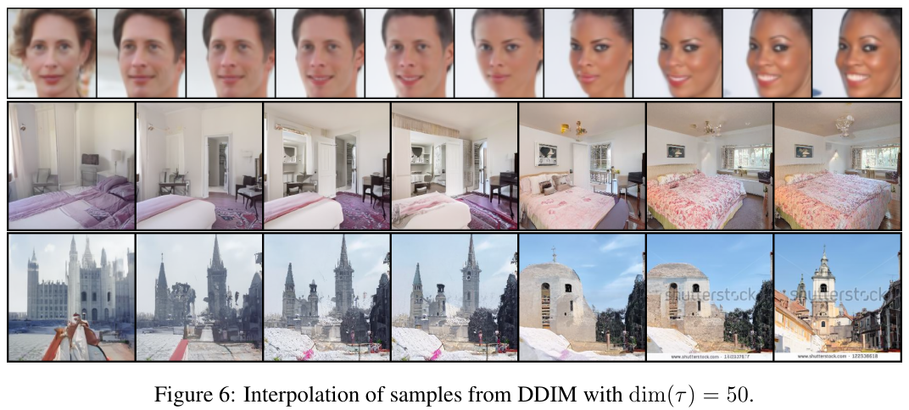
DDIM – Experiments

Slide 31
Conclusion
Markovian process of DDPM to Non-Markovian process of DDIM
Generalization
Generative process can be deterministic
Allowing trade off computation for sample quality
Semantically meaningful image interpolation in latent space

Slide 32
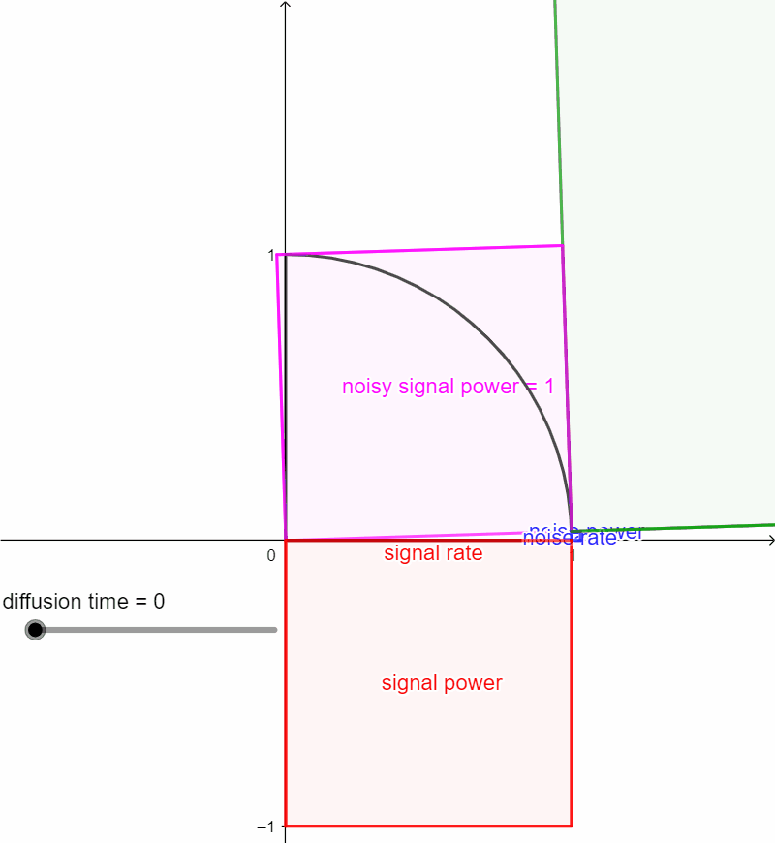
Furthermore
Diffusion model in a view of signal and noise
DDIM to Neural ODE and SDE
Connection to score-based generative models
https://keras.io/examples/generative/ddim/

Slide 33
Thank
You
감사합니다.

